Slide 1
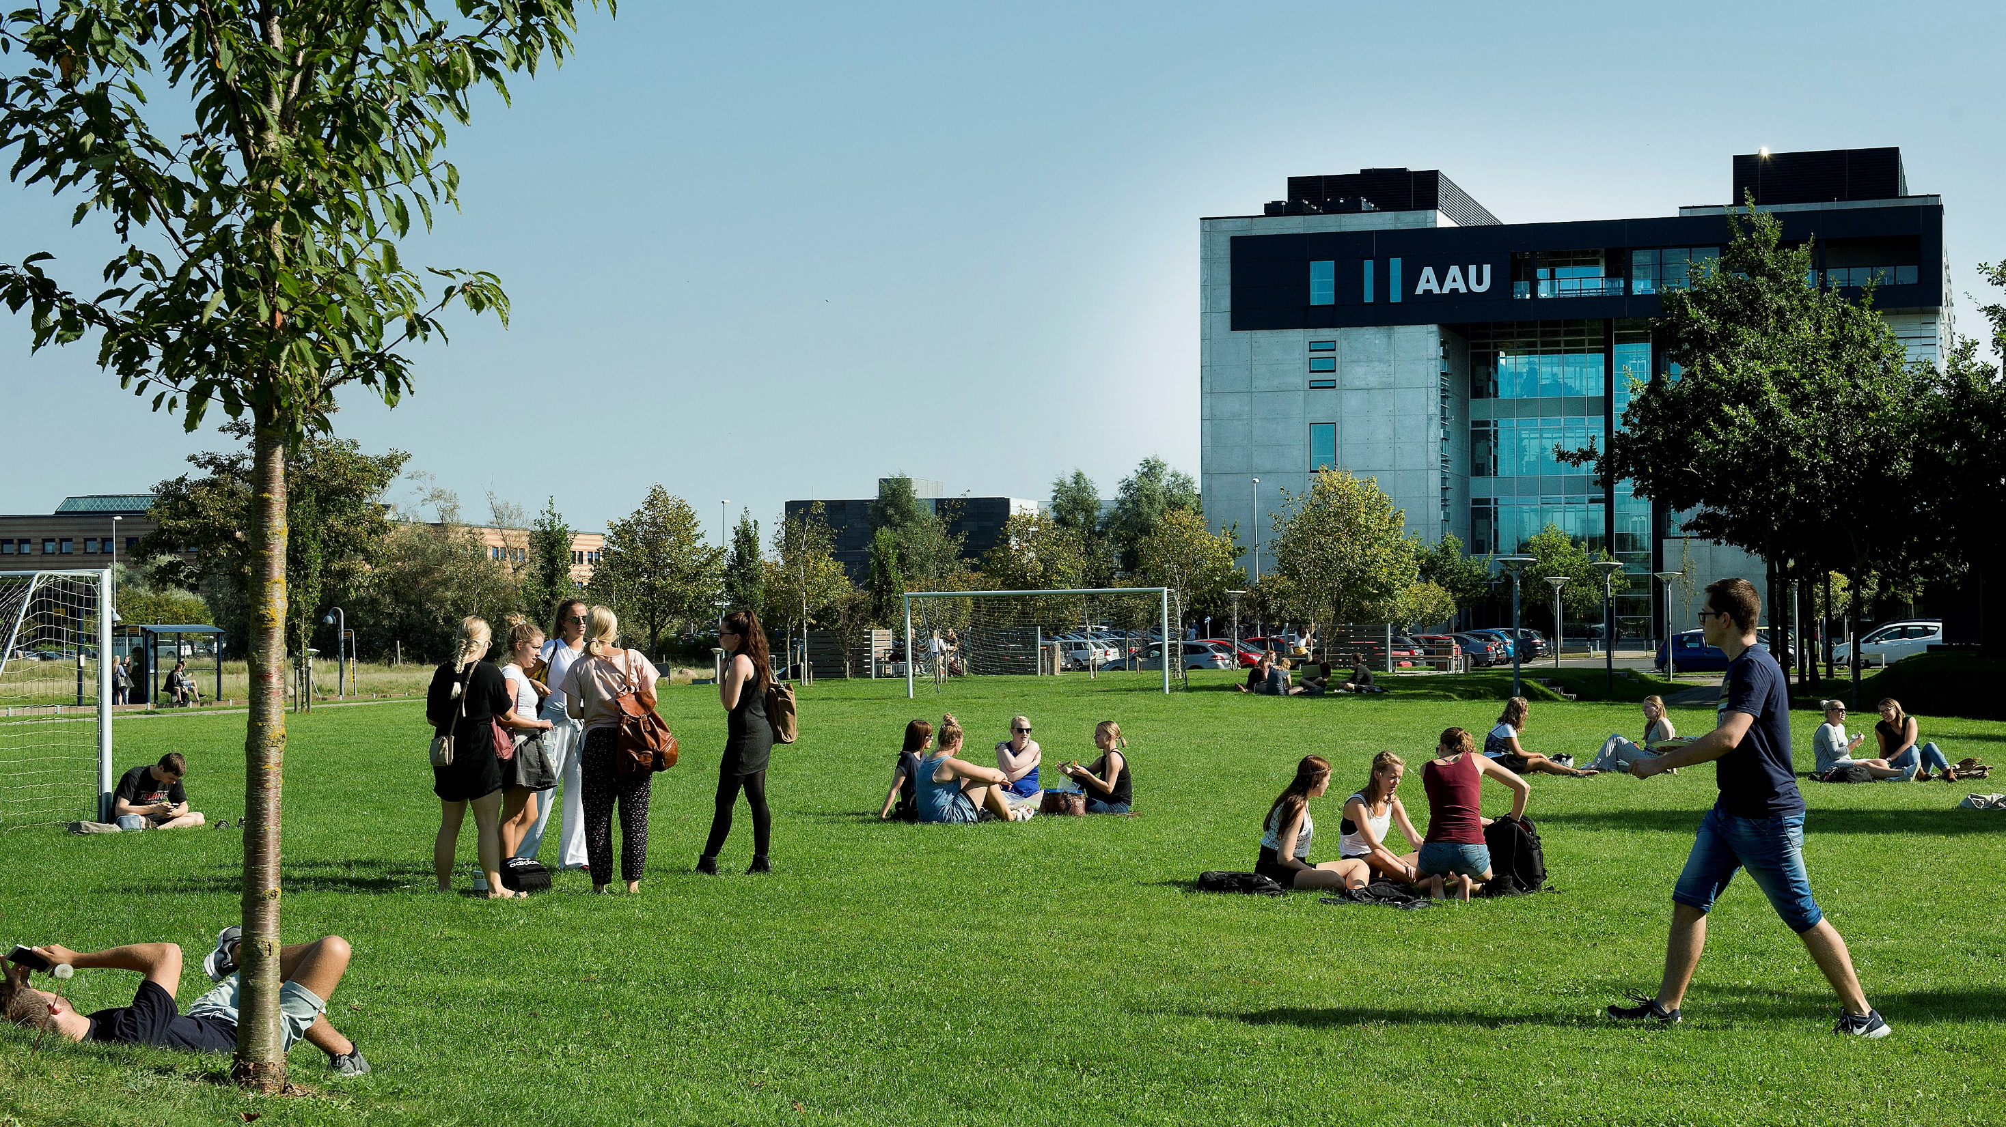

Slide 2

CONTENT
GENERAL GUIDELINES
STUDENTS
PBL
RESEARCH AND RANKING
BUSINESS COLLABORATION
STRATEGY 2016-21

Slide 3
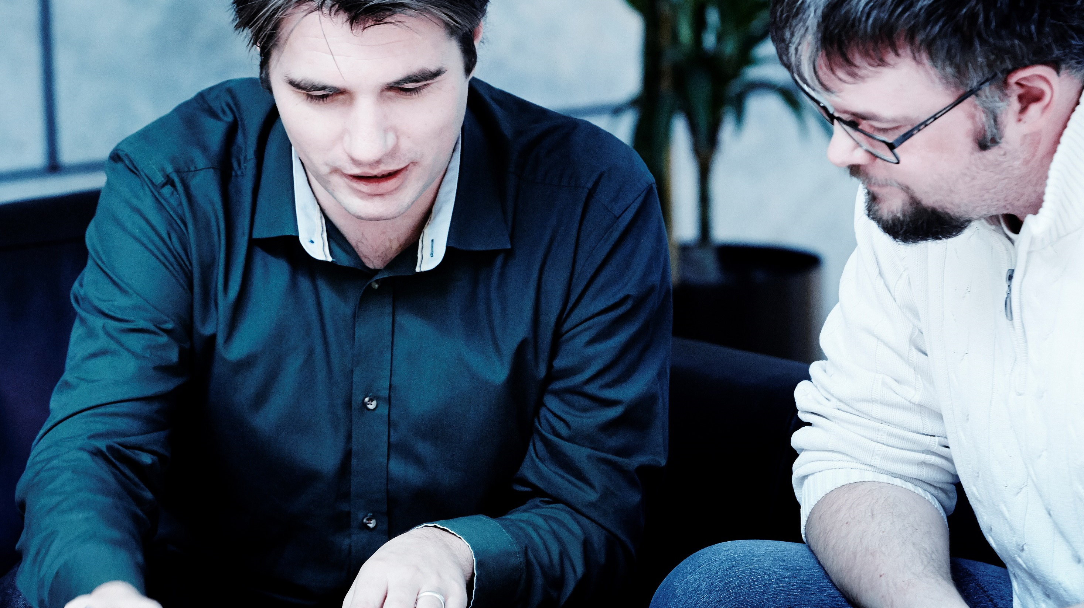
Introduction, change random picture

Slide 4
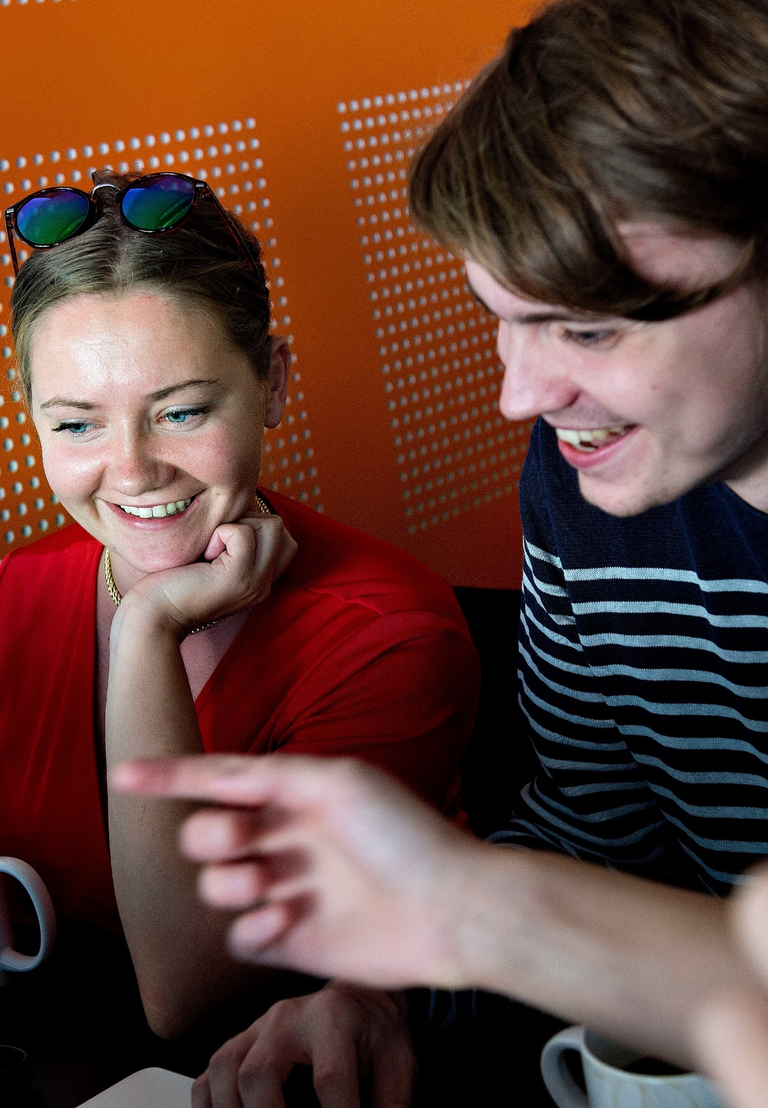
AAU – KNOWLEDGE FOR THE WORLD
All degree programmes and research activities at Aalborg University are problem and project-based and have an interdisciplinary focus.
Through strong interplay between staff and students and intense collaboration with public and private sectors, we offer degree programmes with a real-world approach and provide world-class research.
This results in new insights, new solutions to societal challenges and knowledge that changes the world.

Slide 5
AAU – KNOWLEDGE FOR THE WORLD
All degree programmes and research activities at Aalborg University are problem and project-based and have an interdisciplinary focus.
Through strong interplay between staff and students and intense collaboration with public and private sectors, we offer degree programmes with a real-world approach and provide world-class research.
This results in new insights, new solutions to societal challenges and knowledge that changes the world.

Slide 6
Time Management Table
Name | Time holding breath under water | Time without criticizing work | Time used for eating
Nicolai | 29:10 | 29:10 | 20:00
Thassilo | 10:02 | 10:02 | 20:00
Aitor | 00:17 | 00:17 | 20:00
Nicolas | 19:57 | 00:00 | ∞

Slide 7
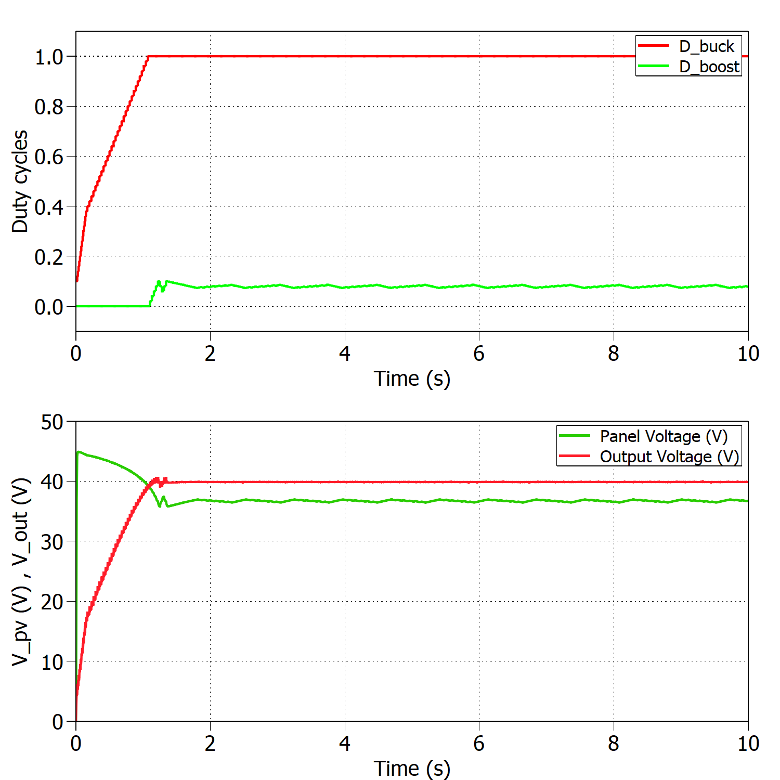
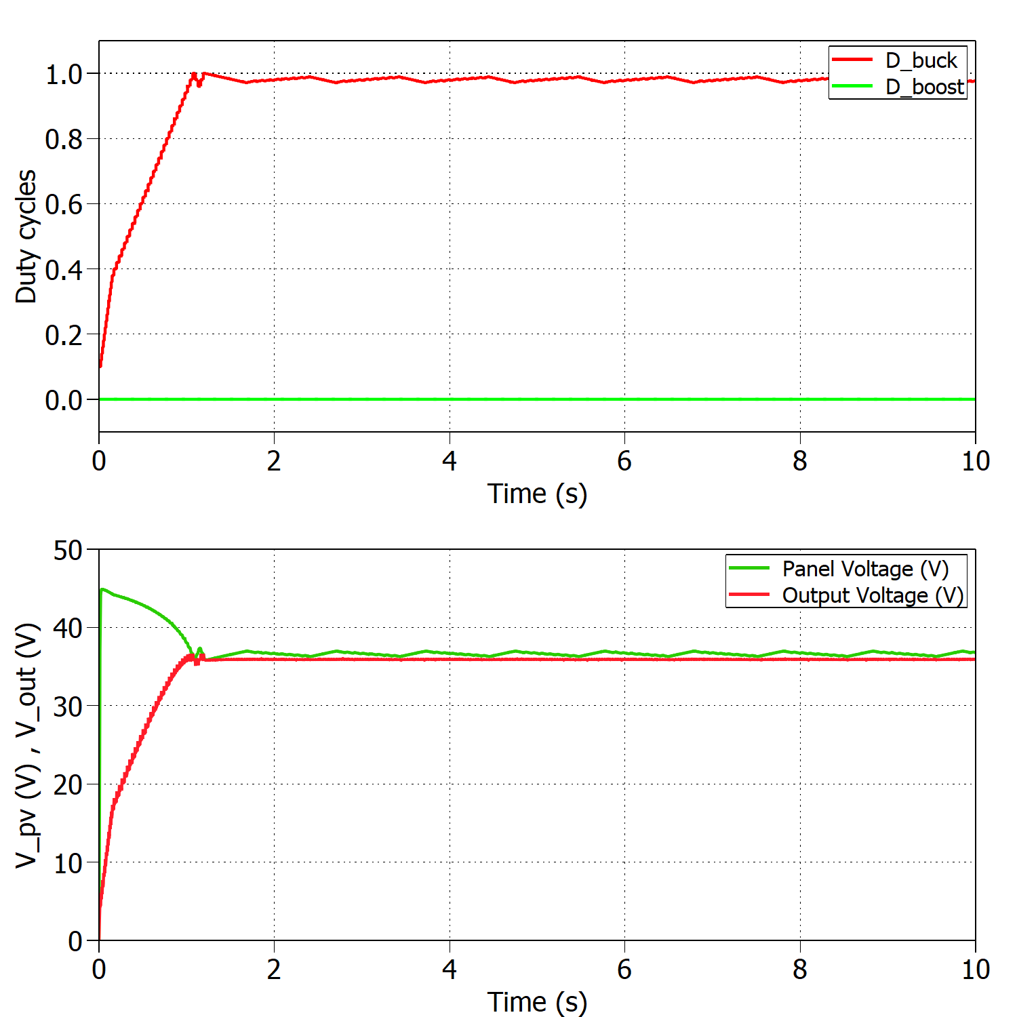
Time Management Table
Add a nice looking caption if you have multiple figures at one slide
And make sure that they are better aligned than this…

Slide 8
Converter design, change random picture

Slide 9
Converter design, change random picture

Slide 10
Converter design, change random picture

Slide 11
Mppt → Final implementation/fsm gif reaching MPP --------------------------- test setup and plecs --------------------------------- problems: driver, inductor, software filter

Slide 12

Maximum Power Point Tracking
Maximum Power Point Tracking

Slide 13
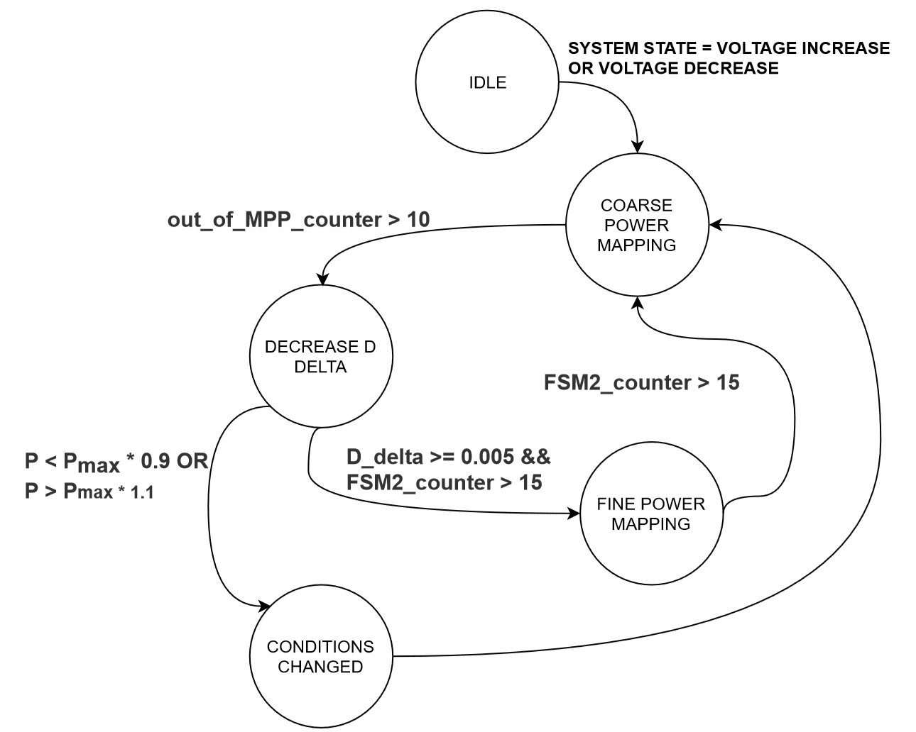
Final implementation
System voltage and current were read too fast after duty cycle change
Duty cycle step decreased after false positive MPP detection → System became slower
System couldn’t address changes in irradiance or load

Slide 14
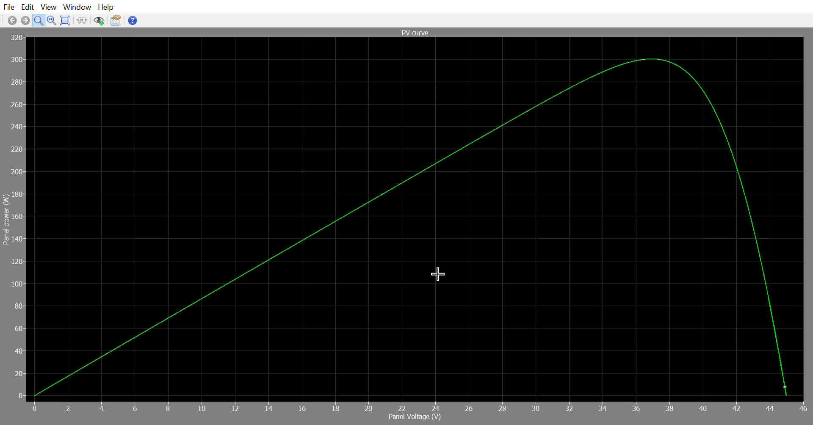
Final implementation
3 seconds sim time
Boost, 8 panels

Slide 15
Final implementation - discussion
Discuss main limitations of the system
TBD (from discussion)
Item 1
Item 2

Slide 16
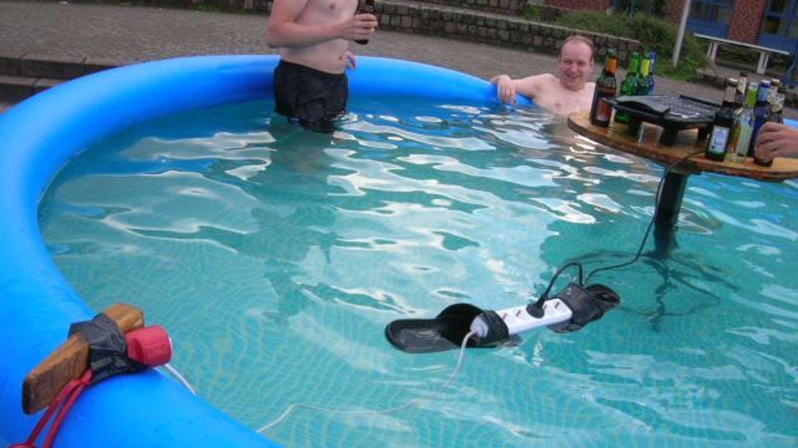
Testing
Testing

Slide 17
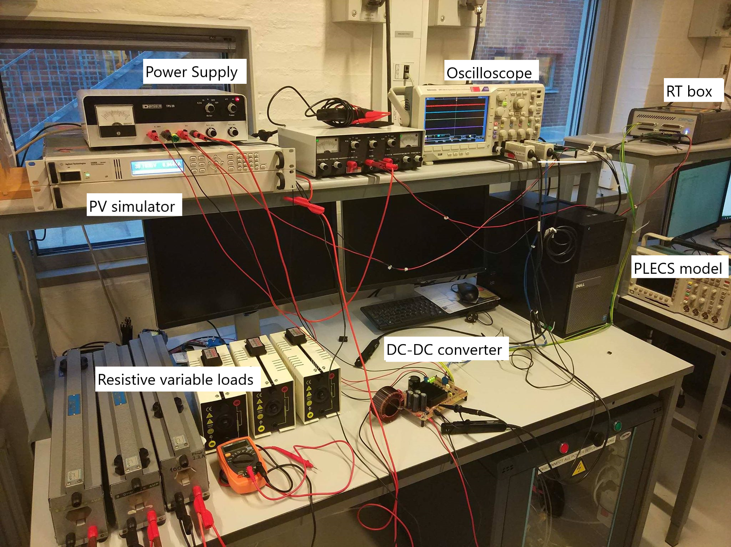
Test setup-does it make sense to explain test setup without having introducing testing activities?
RT-BOX
Optical isolation
Picture with rtbox-specific plecs blocks

Slide 18
Testing
discussion

Slide 19
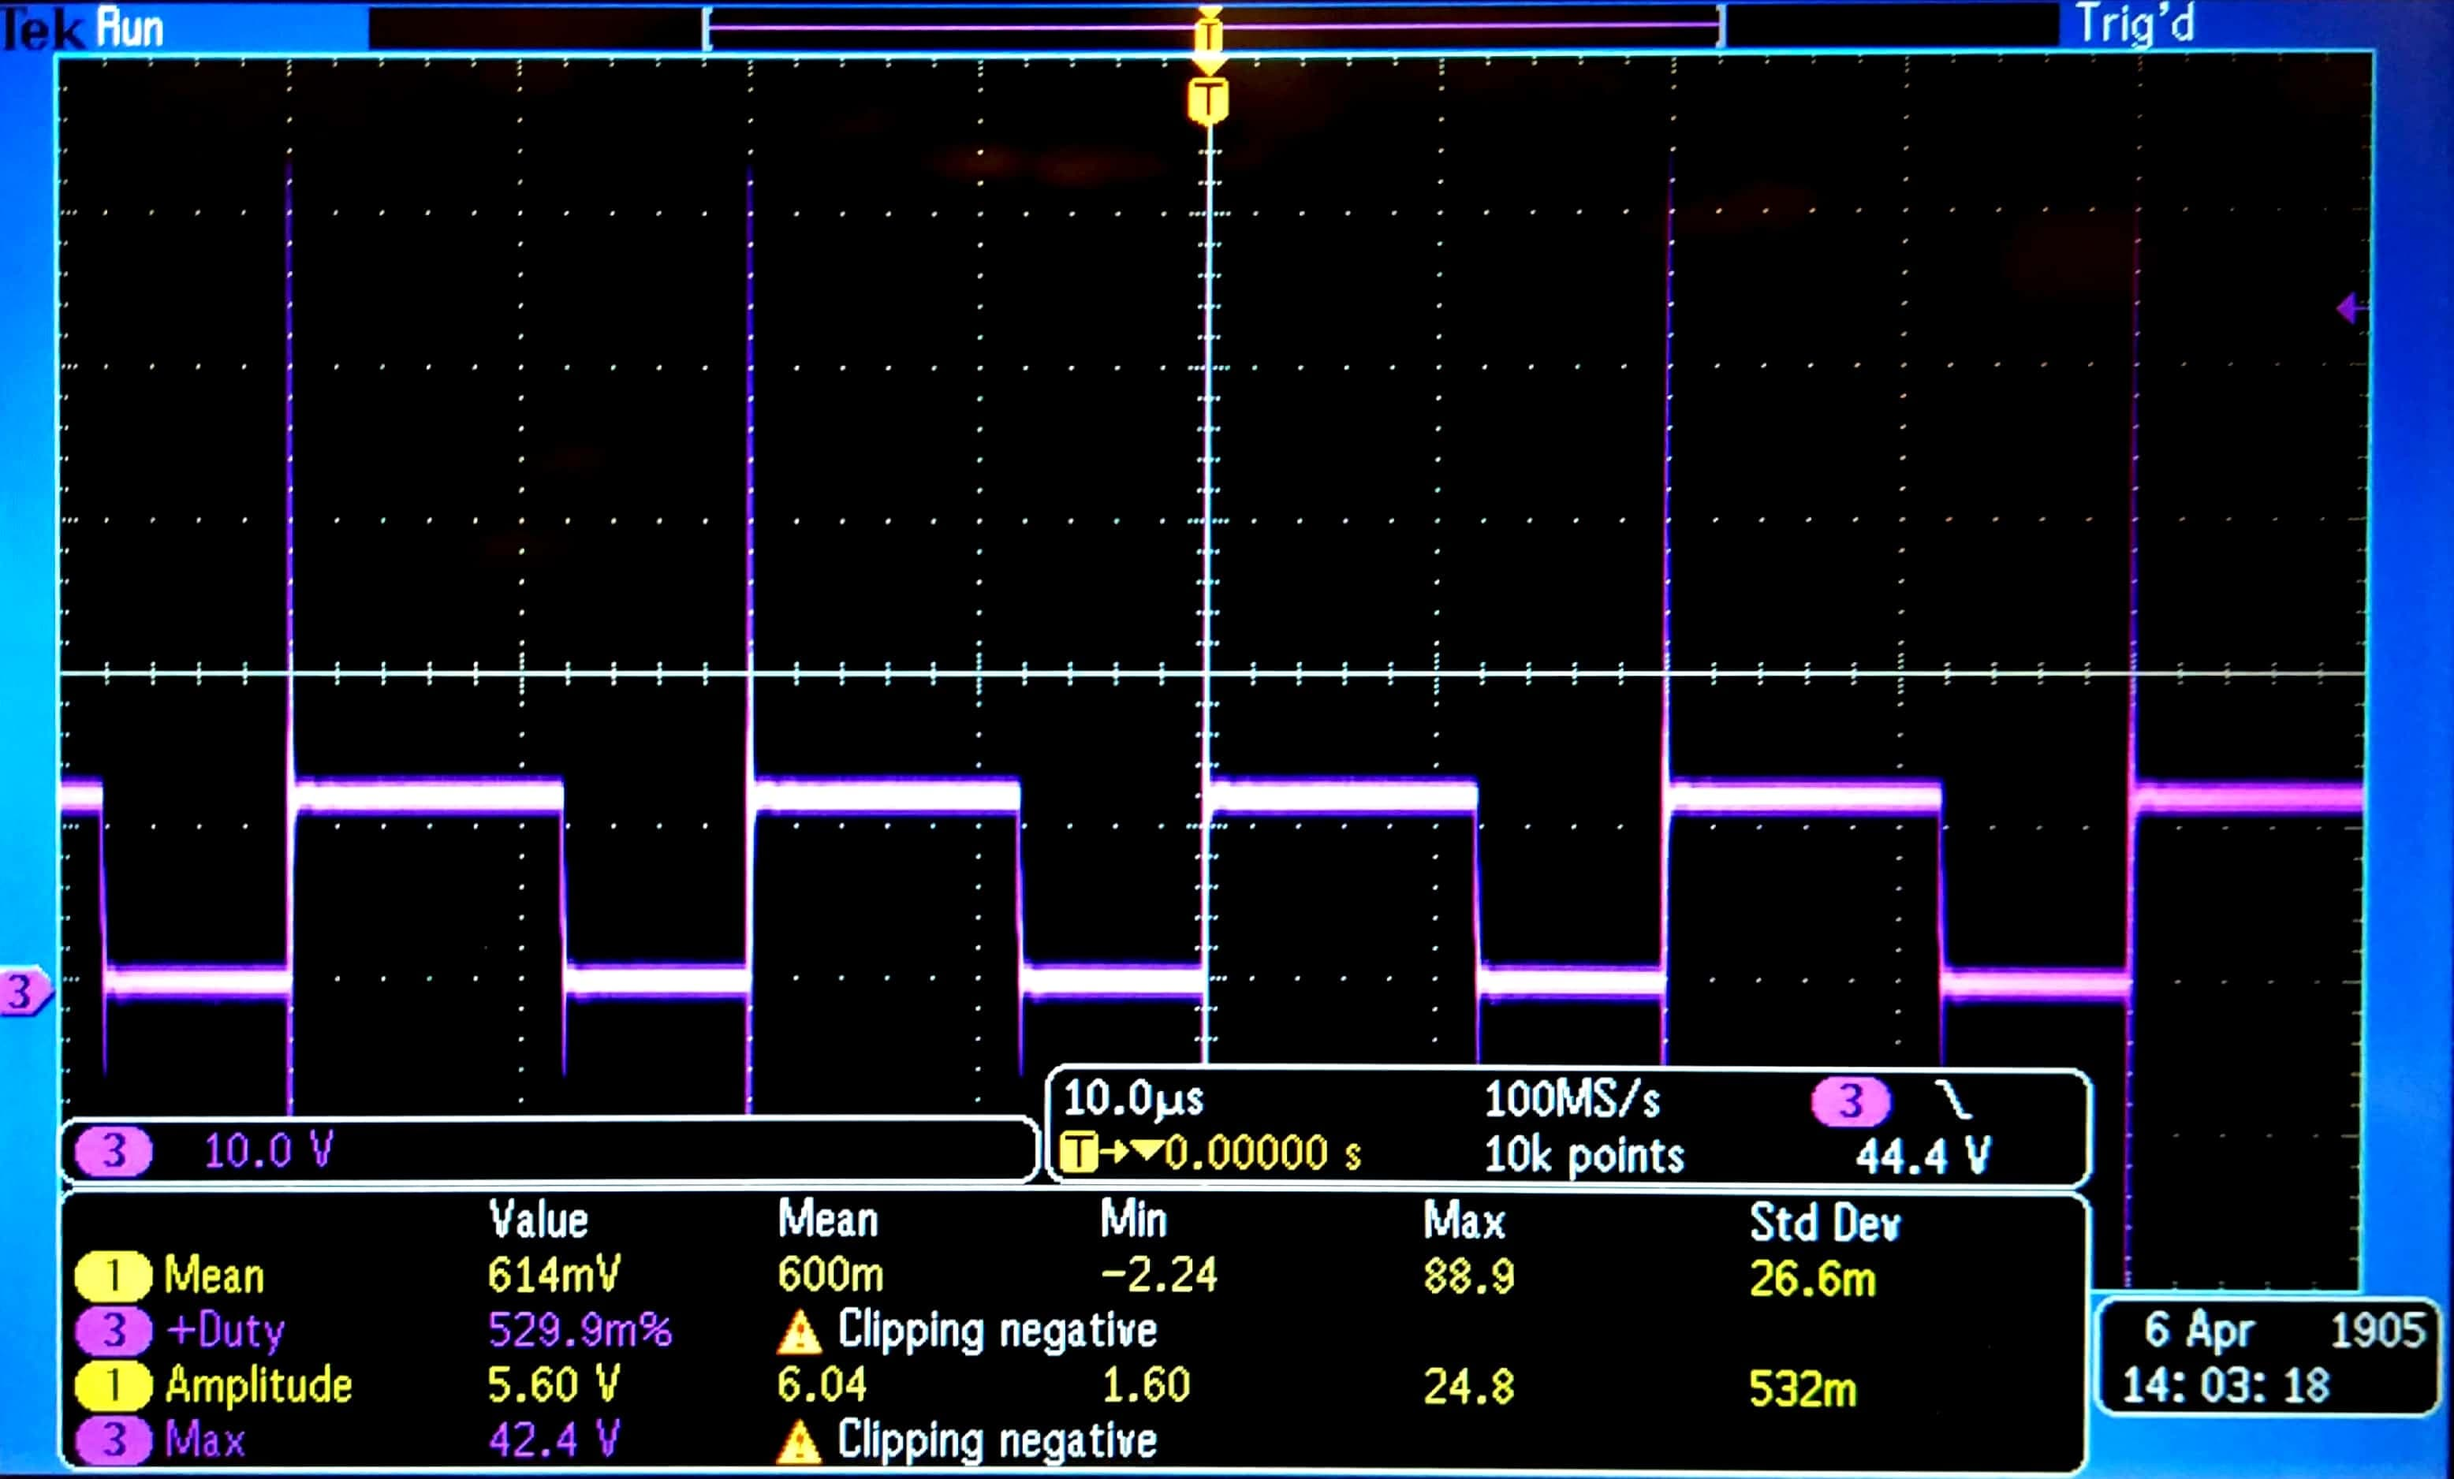
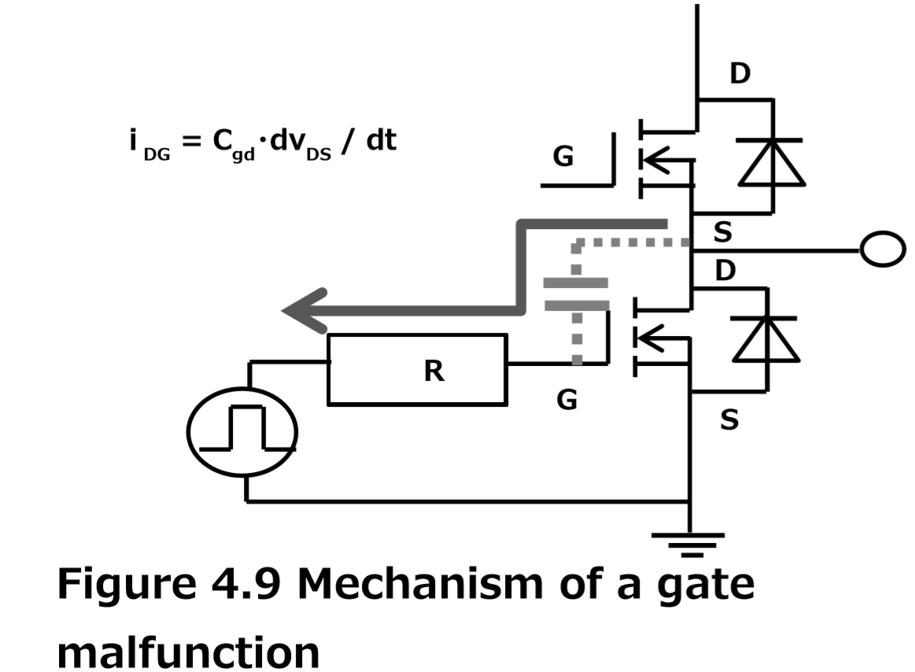
Driver issues
Voltage spikes at gate
[1] ADD REFERENCE

Slide 20
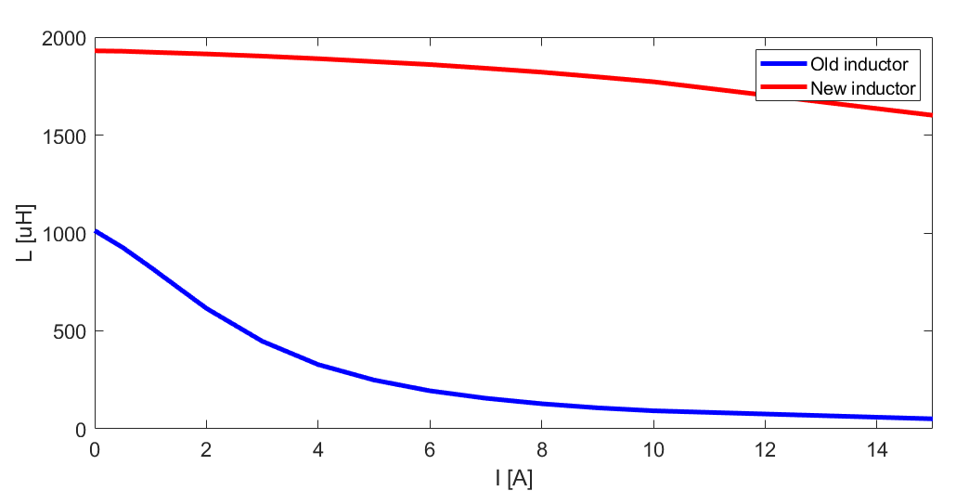
Inductor

Slide 21
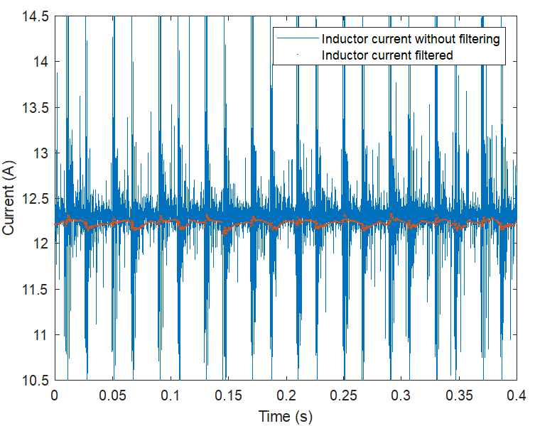
Software filtering
V and I measurements are noisy
HW filtering at the output of the sensor is not enough
Single pole LPF implemented

Slide 22
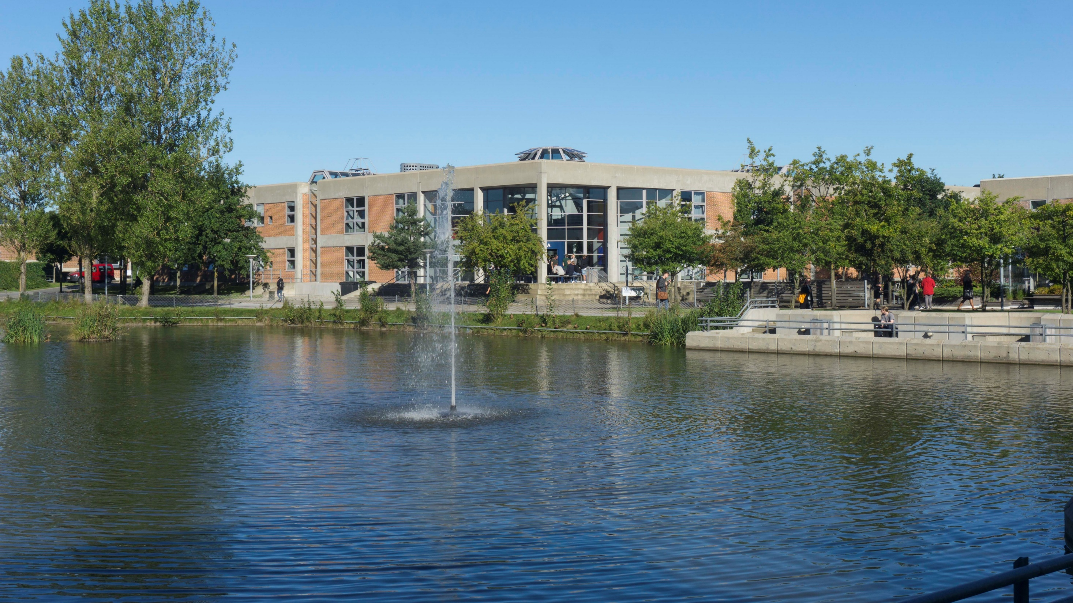
Thank you for your attention
Questions?

